Slide 1

MAKING LIFE EASIER ONE WASH AT A TIME
Maitrey Desai, Ava Groh, Tyler Yin, and Ryan Satarawalla

Slide 2


Scarlet
Wash
Description of Our Business Concept
An all in one business that supports college students through a service of doing their laundry at an affordable cost.
The product is a single time service with a supplement of a monthly based membership for long time members

Slide 3

Scarlet
Wash
Customer Value Proposition
Scarlet Wash builds the bridge to a convenient and time saving alternative to the current college laundry routine by eliminating one of the most time consuming weekly tasks. Instead of spending useless time searching for empty open machines, waiting for cycles to finish, folding clothes, and balancing laundry around academic and social commitments, students can rely on our affordable membership plans for consistent, dependable service. With very simple drop off and pick up locations, Scarlet Wash takes care of washing, drying, and returning clothes folded so students can always maintain a closet full of clean, fresh clothing without interruption to their schedules. Our service allows the ever busy studentst to embark on other meaningful tasks. By offering convenience, quality, and value, Scarlet Wash supports students in achieving a better balance and maximizing their college experience.

Slide 4
Scarlet
Wash
Vision , Mission , & Core Values
Vision - Redefining the way college students manage their time by lifting the burden of laundry from their daily lives.
Mission- Simplifying student life by providing affordable, reliable, and stress-free laundry services, this venture partners with universities to offer on-campus laundry drop-off and pick-up locations, flexible subscription or pay-per-use options, and adequate turnaround times. By replacing the hassle of laundry with a service designed specifically for students, we save students time, stress, and ensure fresh, ready-to-wear clothes. Focused on convenience, quality, and value, our service empowers students to optimize their time and focus on what matters most.
  Affordability - Using a budget friendly cost for the plans, puts students financial worries out of the way while focusing on helping students
  Quality/efficiency – Holding high standards to ensure the customer that they can have full faith that their articles of clothing will be in good hands.
  Sustainability – Using environment-friendly practices such as energy-efficient machines to environmentally safe detergents, bulk loads to reduce the water pollution
  Convenience - Utilziing the Rutgers infrastructure for seamless pick up and drop off locations that are convenient for students
  Reliability - Ensuring clean laundry from when the customer drops off their clothing and returning clean laundry ready for pick up
  Collaboration – We will work closely with universities, student organizations, and local partners to ensure our services truly meet student needs.
  Customer-Centric Care – Putting resources of feedback, to get direct feedback from our customers and focusing on their needs

Slide 5

Scarlet
Wash
Financial and Strategic Objectives
Financial Objectives
  Reach a total of 200 monthly subscribers by the end of the month, increase in another 15% annually to cover our operating costs
  Increase to $250,000 in net income with partner universities within the first three years of operation, funded through memberships, single-use services, and institutional partnerships
  Maintain a minimum 15% surplus by year 3 by streamlining laundry operations, negotiating supplier contracts, and reducing overall water waste ensuring consistent contributions back to the university community.
Strategic Objectives
  Increase in new student sign ups by 15% by the end of the upcoming semester
  Maintain at least a 70% returning-customer retention rate by the end of the semester, and each semester preceding. Offering loyalty rewards, quality guarantees, and responsive customer service.
  Establish three permanent laundry drop-off/pick-up locations on campus within 18 months.
  Increase managed successful operations in 2 new universities by the next 2 years.

Slide 6

Scarlet
Wash
Corporate Social Responsibility Key Initiatives and Rationale
Scarlet Wash will adopt a proactive CSR culture
Rationale for team’s decision - Builds trust and goodwill with students, faculty, and community
  Differentiates Scarlet Wash from competitors.
  Reduces negative publicity, enhances brand loyalty
  Encourages sustainable practices and long-term cost savings
  Emphasize our goal to benefit the health and well being of students
Reputation and student trust are a central priority for Scarlet Wash. As a campus service, aligning with student values (convenience, sustainability, fairness) will directly strengthen loyalty.

Slide 7

Scarlet
Wash
Description of New Product/Service selected by the team
1. Express Same-Day Rush Service
  Premium fee for guaranteed same-day turnaround on bags dropped by a morning cutoff
  Limited daily capacity to preserve quality and justify pricing
  Ideal for athletes, performers, interviews, and lab classes
2. Stain Care and Minor Repair Add-On
  Per-item pricing for stain treatment, rewash, loose button sewing, small seam fixes
  Increases average order value without slowing core operations
  Clear menu and photo-based proof of work for trust and transparency
3. Seasonal Clean-and-Store Service
  End-of-semester clean, vacuum-seal, and climate-controlled storage for bulky items like coats, blankets, comforters
  Pick up in May, return in August during move-in
  Recurring, pre-paid packages that smooth summer cash flow

Slide 8
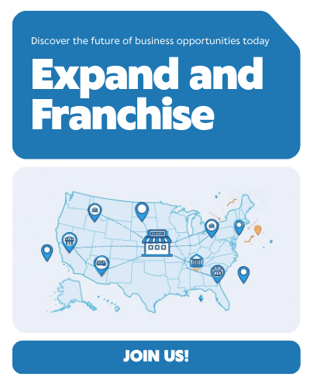
Scarlet
Wash
National expansion decision, approach, and rationale
  National Expansion Decision
    The team decided YES, Scarlet Wash should expand nationally.
    Campus operations have proven successful and attracted interest from universities across the country.
    National growth aligns with the mission to increase student impact and maximize university donations.
    Benefits outweigh risks when expansion is managed carefully.
  Chosen Approach: Franchising
    Franchising selected as the best strategy for national growth.
    Allows rapid expansion without heavy financial strain.
    Students at each campus can operate local chapters under a standardized model.
    Ensures operational consistency while spreading the nonprofit mission.
  Rationale
    Lower risk: avoids raising large amounts of capital and overstretching resources.
    Scalable model: growth can occur quickly through multiple campuses.
    Mission protection: franchise rules require donations back to each university
    University partnerships: structured framework helps expand impact to more students nationwide

Slide 9

Scarlet
Wash
Selected Country for Global Expansion & Why
Country Selected: Canada
  Opportunity: We have very similar Cultures. Low cultural distance to the US, particularly in high individualism and low power distance, suggests that our Scarlet Wash business model would require minimal adaptation.
  Challenges: The projected modest GDP growth (1.16% in 2025) and slightly higher unemployment (7.01% in 2025) may limit short-term student spending compared to peak economic times.
  Overall Rationale: Canada offers the lowest risk and easiest entry due to its geographic proximity, economic stability, and strong institutional support for foreign business. Most importantly, the high cultural similarity to the US

Slide 10

Scarlet
Wash
Expansion Strategy, Entry Strategy, and Rationale
  Expansion strategy
    We selected a hybrid global/local strategy, keeping core Scarlet Wash operations standardized while customizing detergents, pricing, and sustainability features to match Canadian expectations and local university regulations.
  Entry Strategy
    For international entry, the team chose a Joint Venture approach to partner with experienced local operators, allowing greater control over procedures, faster regulatory approval, and smoother operations in a foreign environment.
  Rational
    The rationale highlights that Canada is the lowest-risk international market due to strong cultural similarity and stable institutions, and a joint venture ensures both local expertise and organizational control, improving operational success and compliance.

Slide 11

Scarlet
Wash
Compensation Plan:
  $15.50/hour (competitive with Rutgers on-campus pay)
  Free laundry service (employee perk)
  Volunteer recognition certificates for those working unpaid hours
  Incentives: $50 monthly attendance bonus and performance-based rewards for meeting delivery deadlines.
  Benefits: Flexible scheduling, free laundry service for personal use, and potential for promotion to Shift Lead.
Advertising Plan:
  Post job listings on Rutgers Handshake, indeed, and Flyers on campus bulletin boards.
  Promote on Instagram and Rutgers student group pages.
  Offer referral bonuses for current employees who recommend new hires.
Criteria for selection:
  Reliable availability that fits the Scarlet Wash schedule
  Demonstrated responsibility and punctuality (references or previous work)
  Friendly, service-oriented personality
  Interest in community/non-profit work
Key Job:
Laundry Attendent
Responsibilities:
  Sorting, washing, drying, and folding laundry according to order specifications.
  Inspecting clothing for stains or damage before washing.
  Maintaining cleanliness and organization of the laundry area.
  Folding Clothes that meet our quality standard
  Tracking and labeling orders accurately to avoid mixups.
  Meet quality and time standards for all laundrybatches.
Qualifications Required:
  High school diploma or equivalent.
  Strong attention to detail and time management.
  Basic knowledge of laundry chemicals, machines, and fabric care.
  Ability to lift up to 50 lbs and work in a fast paced environment.
  Prior experience in laundry or housekeeping preferred.

Slide 12

Scarlet
Wash
Employee Motivation Initiatives
  We will introduce an Employee of the Month program to highlight great work. Each month, one team member will be recognized for reliability, teamwork, or excellent service. The winner will receive a small reward such as a Rutgers dining gift card or a local cafe voucher. This program will help employees feel appreciated for their effort and commitment.
  Since most employees are students, Scarlet Wash will be flexible in scheduling shifts to support the variety of class schedules employees may have. This approach will reduce stress, improve work satisfaction, and allow everyone to perform at their best without having to sacrifice academic priorities
  Scarlet Wash will begin short training sessions focused on customer service, time management, and proper equipment use. These sessions will help employees gain practical skills that can be applied in future jobs while also improving the overall quality of work.
  Scarlet Wash will hold casual team gatherings each month such as pizza nights or study breaks. These events will give everyone a chance to connect and share feedback, as well as serve to strengthen the sense of community within the workplace.
  Employees who consistently meet or exceed expectations will be eligible for small bonuses or recognition. These rewards will encourage strong performance and increase the sense of responsibility employees have in maintaining the quality and reputation of Scarlet Wash.

Slide 13

Scarlet
Wash
Announcement of Employee Departure
Subject: Strengthening Our Team
Dear Scarlet Wash Team,
We want to take a moment to share that two of our team members have decided to step away from their positions effective immediately. As a management team, we recognize that this is on us — we could have done more to support and engage everyone, and we take full responsibility for learning and improving from this.
While their departures were unexpected, we respect their decisions and wish them the best moving forward. This moment reminds us how important it is to maintain an engaging, supportive, and motivating environment for everyone here. After reviewing internally with our executive staff. To strengthen our team culture and ensure every member feels valued, we’re implementing a few new initiatives starting this month:
  “Laundry Leader of the Month” recognition program to celebrate your hard work and give you a bonus.
  Flexible scheduling options to help balance work and academics.
  Free laundry benefits and small perks during longer shifts.
  Monthly team meetings for open feedback and ideas.
  Access to leadership and volunteer credit opportunities at Rutgers.
We’re deeply grateful for everything you do to make our non-profit successful and meaningful. Our mission has always been about community and that starts with the people who make it run every day.
Thank you for your dedication, and let’s keep building something positive together.
Warm regards,
Your Operations Managers

Slide 14

Scarlet
Wash
Keys to Achieving Employee Engagement
Feedback and Listening Systems
  Use short monthly surveys or suggestion boxes to gather feedback.
  Implement an “idea of the month” challenge where employees’ operations-improvement suggestions are tested and rewarded.
Function: Employees thrive when they feel heard and valued. Regular feedback systems encourage open communication and continuous improvement. Rewarding employee ideas shows that leadership takes input seriously, promoting a two-way relationship where employees are active contributors, not just workers.
Work-Life Balance and Flexibility
  Provide flexible shifts for student workers to accommodate class schedules.
  Promote well-being through reasonable workloads and supportive leadership.
Function: Supporting work-life balance shows genuine care for employees’ mental health and personal needs. Flexible scheduling reduces stress and burnout, helping employees perform better when they’re at work. When employees feel that their well-being is prioritized, they are more loyal, engaged, and willing to go the extra mile for the organization
Leadership Commitment and Transparency
  Openly sharing goals, challenges, and progress of Scarlet Wash.
  Holding team meetings to recognize contributions and update everyone on impact of the business
Function: to build trust and manager-employee alignment, two critical components of engagement. When employees understand the company’s mission, performance, and challenges, they feel more included and valued. Regular recognition during team meetings reinforces a sense of purpose and belonging, making employees more emotionally invested in the organization’s success
Empowerment and Autonomy
  Allow employees to suggest and implement process improvements (e.g., scheduling system, detergent options, eco-friendly machines).
  Involve them in decision-making to increase ownership and innovation
Function: Empowering employees gives them control and responsibility, which directly increases engagement. When individuals are trusted to make decisions, they feel respected and motivated to contribute creatively. This also fosters innovation and continuous improvement, as employees take pride in shaping how the organization operates.

Slide 15



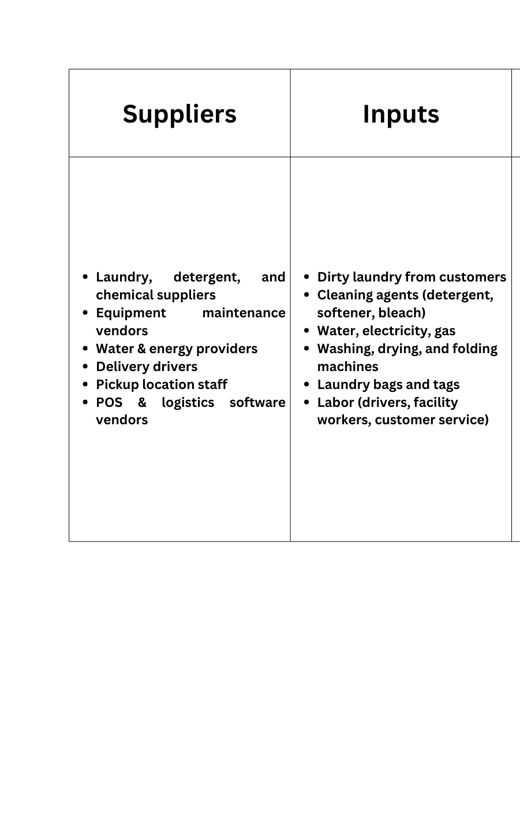
Scarlet
Wash
SIPOC

Slide 16
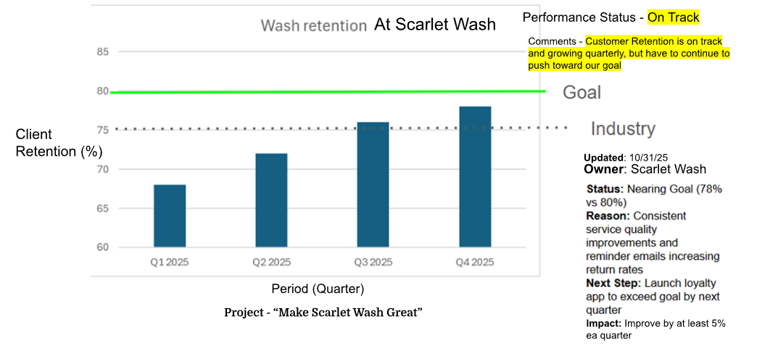

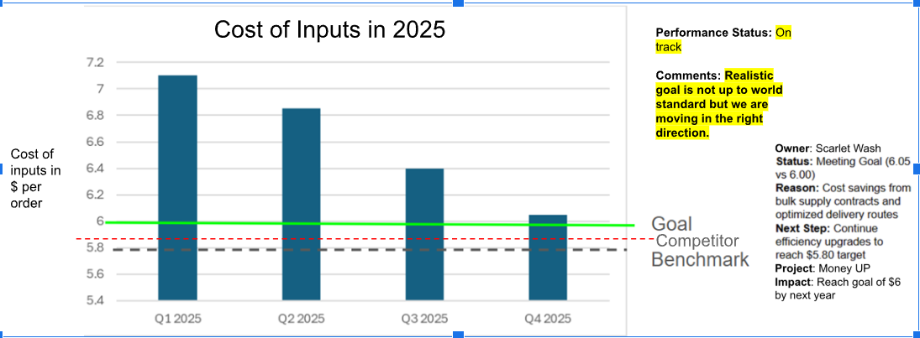

Scarlet
Wash

Slide 17

Scarlet
Wash
Initiative
Effectiveness
Client retention
  Current rate: 78%
  Goal: 80%
To improve customer loyalty, Scarlet Wash will launch a loyalty rewards program and improve the customer experience.
This includes:
  Mobile app that tracks orders and rewards customers.
  Notifications when laundry is ready for pickup or delivery.
  Discounts and referrals to encourage current and new customers.
  Conducting regular quality checks and sending out customer satisfaction surveys.
These changes will make the process more customer-centered, increase satisfaction and help us expand. This will help Scarlet Wash reach an 80% retention rate within the next quarter and 90% by the end of 2026.

Slide 18

Scarlet
Wash
What Our Business Decided
  We will not sell because our mission is rooted in serving the college and students. By selling to buyers with no experience or commitment to that mission would undermine our founding purpose.
  The sale would financially benefit a small group of shareholders while negatively affecting employees, students, and the college itself that relies on our services and social impact
  Accepting the offer could damage our long-standing reputation, weaken our community-centered brand identity, and jeopardize the trust built with customers who value its nonprofit commitment.
  The buyers’ lack of operational experience and their casual, “for fun” business approach pose serious risks to the long-term stability and sustainability of our company, turning short-term financial gain into potentially long term failure.
  Instead of selling, Scarlet Wash will pursue alternatives such as mission-aligned investors, strategic partnerships, or expansion funding that support growth without abandoning the organization’s social purpose.

Slide 19
Scarlet
Wash
Why We’re Successful
Scarlet Wash has achieved strong success because it delivers a service that directly addresses one of the biggest pain points for college students: lack of time. By offering an affordable and reliable laundry service through both single-use and membership options, each week, we effectively remove the stressful task students’ schedules. This clear value proposition, saving time, reducing effort, and guaranteeing clean, ready-to-wear clothing has resonated strongly across campus.
Scarlet Wash is also mission-driven with our primary goal being to support student well-being and reinest profits back into our partner universities. Our nonprofit structure has built trust and loyalty among students, faculty, and administrators, differentiating Scarlet Wash from the current, traditional laundry services. Our commitment to affordability, sustainability, quality care, and convenience further strengthens the Scarlet Wash appeal.
Our success is, in large part, due to our focus on smooth operations; We created fast turnaround times, reliable order tracking, consistent quality checks, and strong customer communication. Strategic initiatives such as loyalty programs, flexible subscription options, seasonal services, and new product innovations, like stain care, repairs, and same-day service have helped increase customer retention and expand the average order value.
Additionally, Scarlet Wash’s emphasis on Employee Engagement has created a workforce that wants to be a part of our tean, proven in how they strive to deliver high service and care about college students. Our team is able stay connected and efficient through flexible scheduling, recognition programs, training, and performance incentives.
Scarlet Wash--in our cohesive mission, operations, customer experience, and employee culture--has built a trusted brand that meets real student needs, maintained strong employee retention, and continues to grow sustainably.

